Slide 1
Short Term Load Forecasting
Matthew O’Callaghan
EirGrid Summer 2019

Slide 2
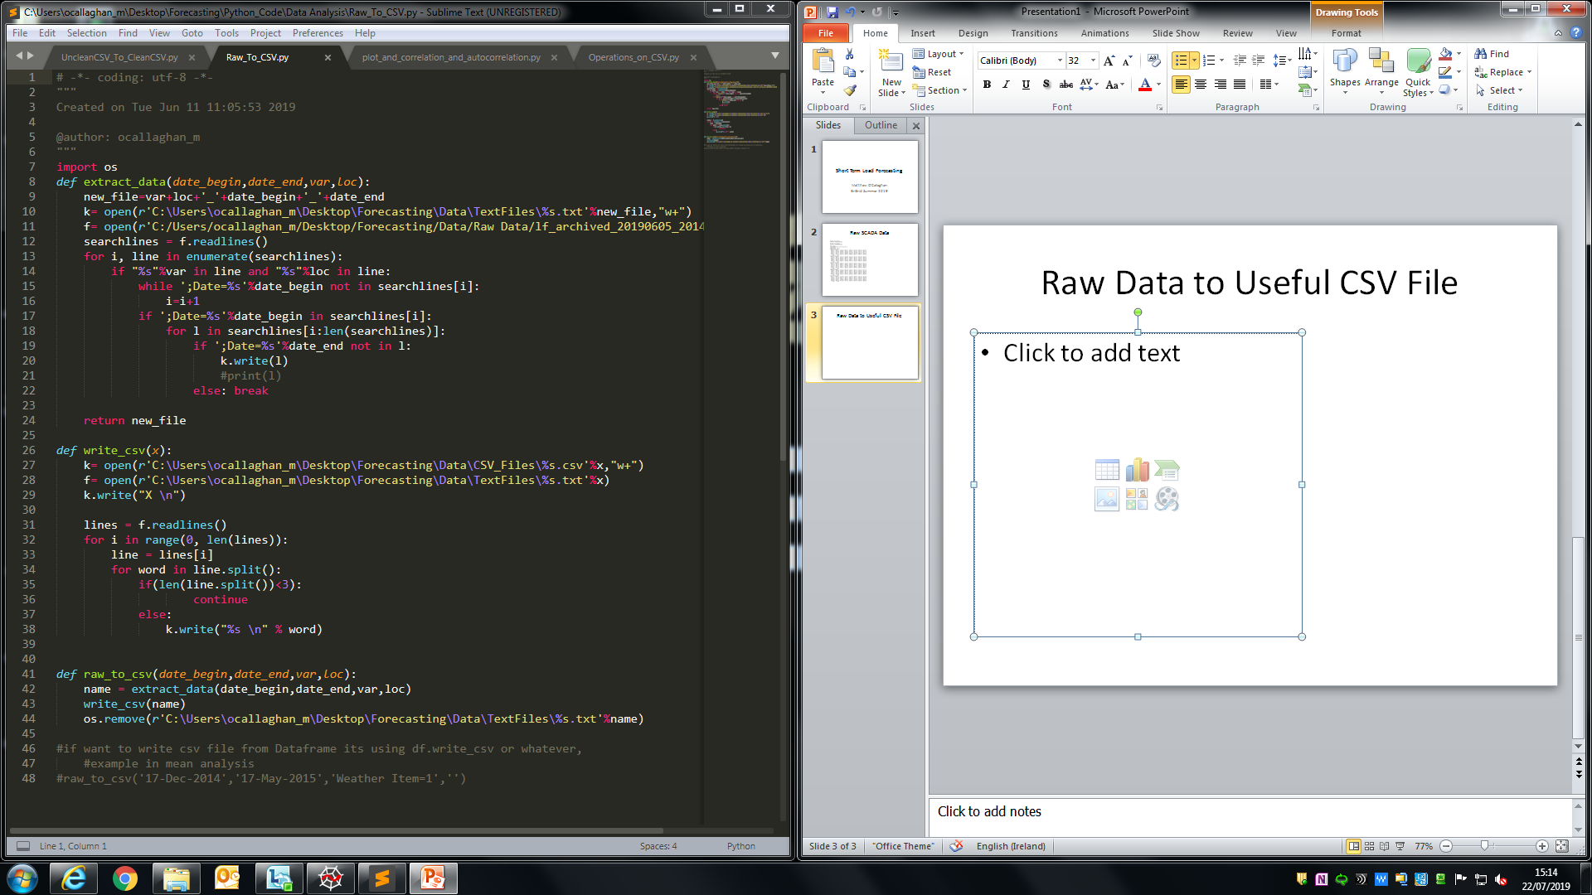
Making Load Data Useful
Raw Text File w/ Bad Format
Create function which:
Opens raw data
Searches for variable (load,temp,etc)
Searches for location (IE/NI)
Searches for start date and extracts data until end.
Outputs and saves as CSV.

Slide 3
Cleaning Data
Data contains 0.00 values for variables in the 49th and 50th half hour spot due to daylight savings. These values dropped.
Only Load data is cleaned. Other variable data is timestamped and outputted as CSV at this point.
Repeated load values and zero load values linearly interpolated.
Updates the CSV file and saves to computer.

Slide 4
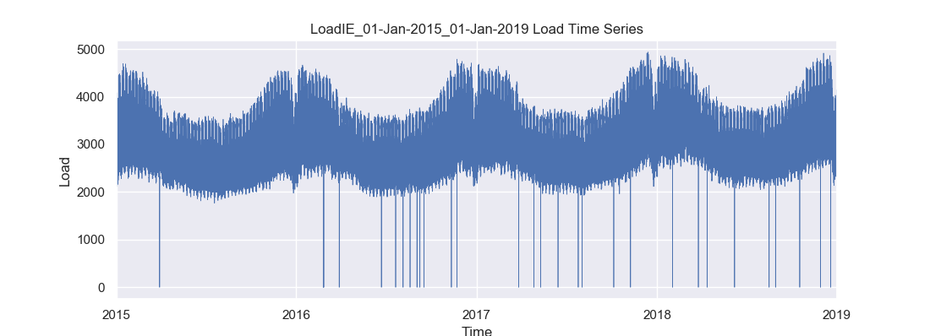
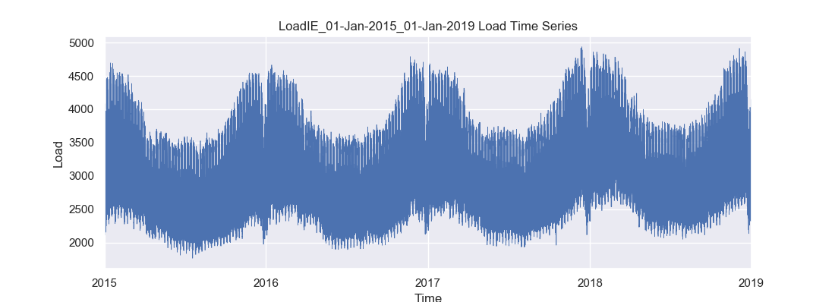
Time Series Plot
Unclean vs Clean Plots
Non Stationary Data

Slide 5
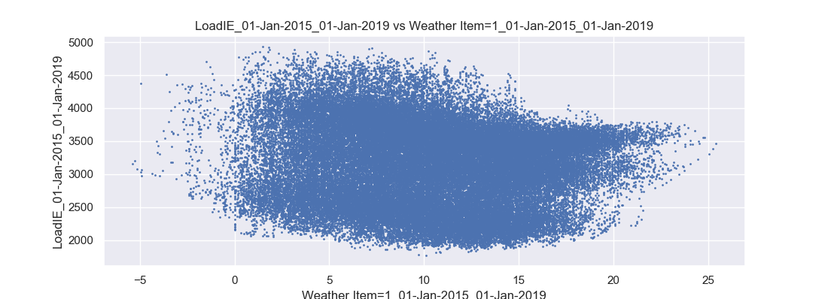
The Search For Correlation Load vs Temperature
Plot Shows Other Variables at Play

Slide 6
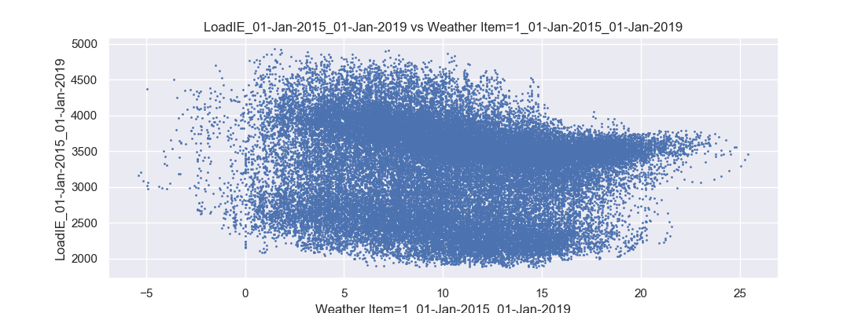
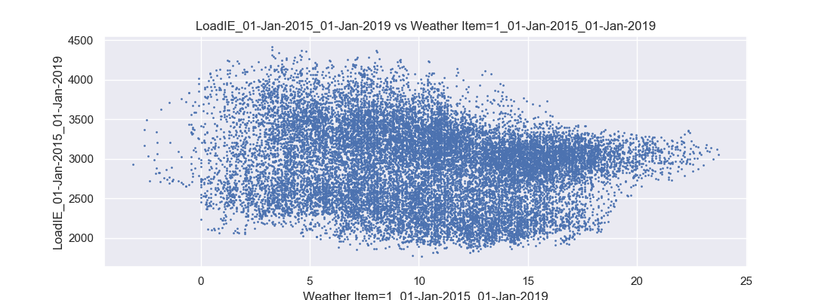
Plot Including Daytype
Type 1=Weekday
Correlation=-0.1
Type 0= Weekend
Correlation=-0.18
Better but not good.

Slide 7
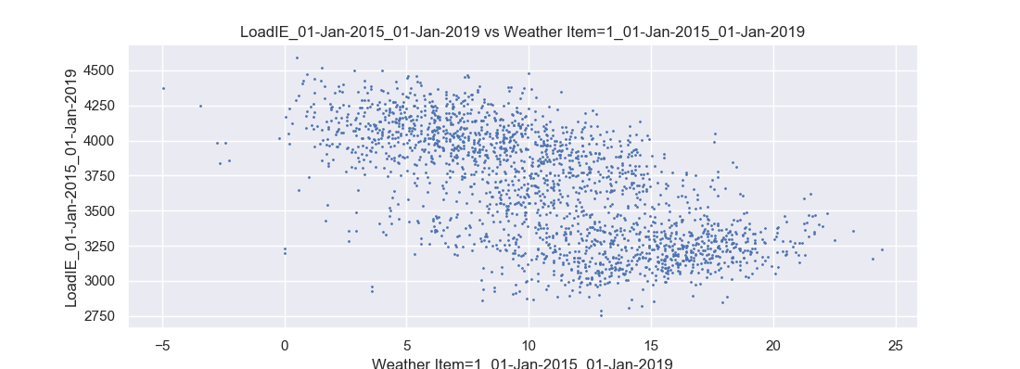
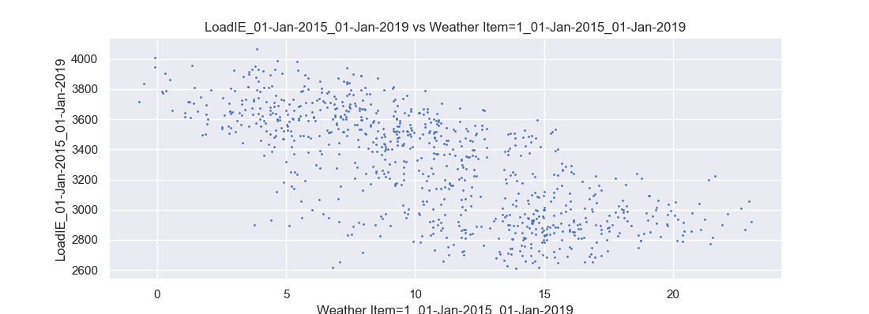
At a given hour
Hour=20:00
Weekday
Correlation=-0.65
Weekend
Correlation=-0.71

Slide 8
Correlations Per Hour Weekday
0 1 2 3 4 5 6 7 8 9 10 11 12 13 14 15 16 17 18 19 20 21 22 23 Average= -0.60 | -0.6367152790601206 -0.6365691568917698 -0.6187419475859376 -0.6068101087493146 -0.5937136112284602 -0.5762768091594677 -0.5270538027608991 -0.4632892717428727 -0.4479628343036517 -0.45747035623133236 -0.5641082391948513 -0.6092604623309616 -0.6226974987648347 -0.620842219034095 -0.598191908225229 -0.5898795244434984 -0.6046657209919643 -0.6433519755457765 -0.6870022635093724 -0.6852955000945066 -0.654887135664315 -0.6336188472561711 -0.5831977775855134 -0.6215215853642266

Slide 9
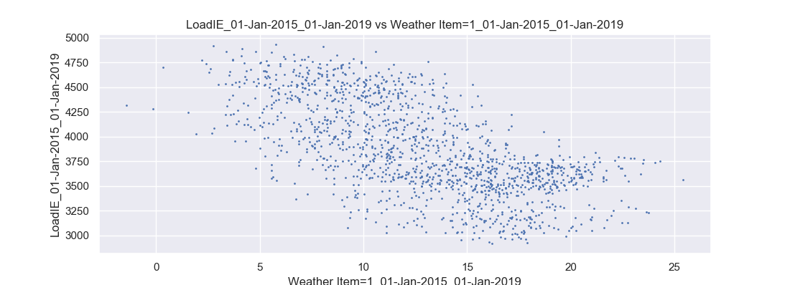
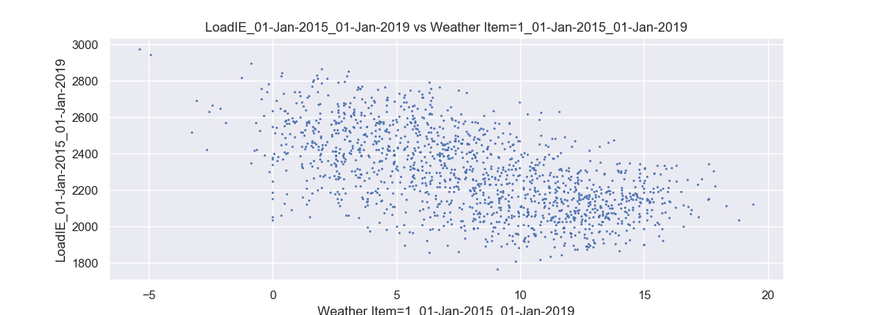
Max/Min: Load vs Temp
Max Min
r=-0.65 r=-0.59

Slide 10
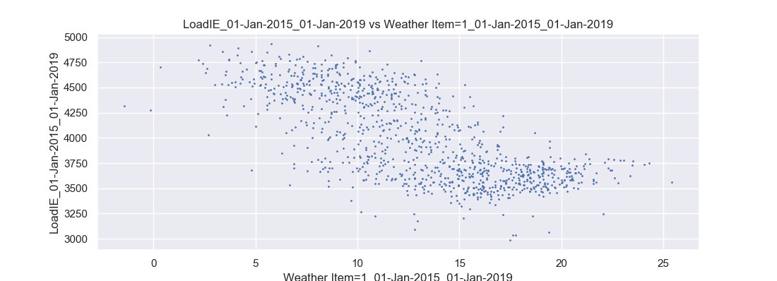
Weekday Max LvsT
r=-0.72
Deadband Exists.
Matches http://doras.dcu.ie/17257/1/d.a._fay_RR.pdf

Slide 11
Other Correlations
Weekday Min L vs T: -0.6
Weekend Max L vs T: -0.76
Weekend Min L vs T: -0.6
Conclusion: Max Load vs Max Temp strongest relationship.

Slide 12
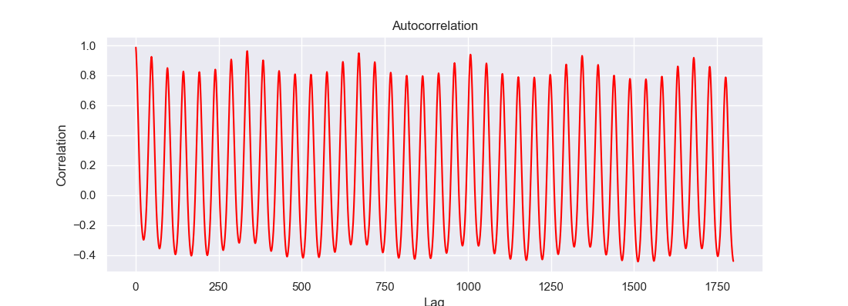
Autocorrelation
Correlation with current load value to previous load values.
Max at 336=7days x 48 half-hours=1 week

Slide 13
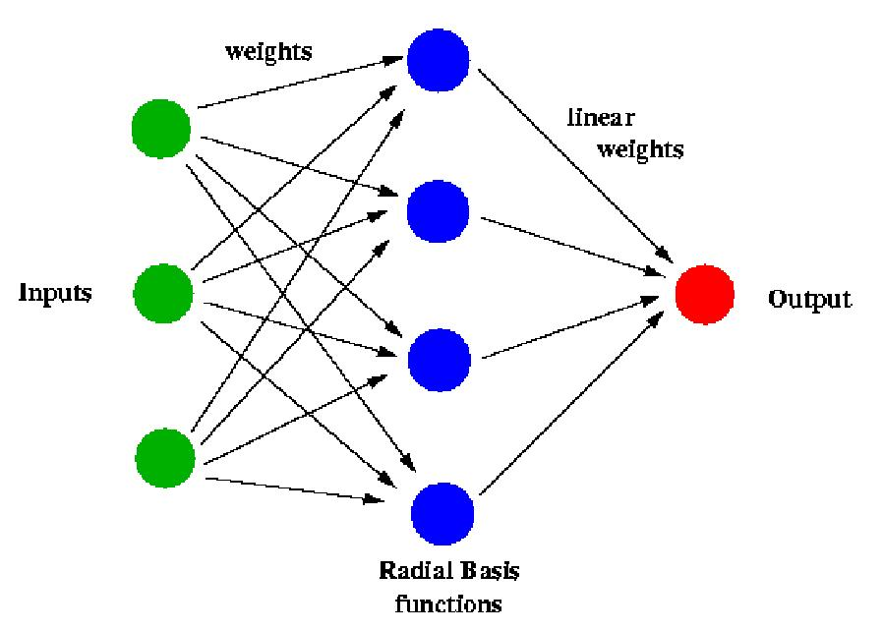
Neural Networks

Slide 14
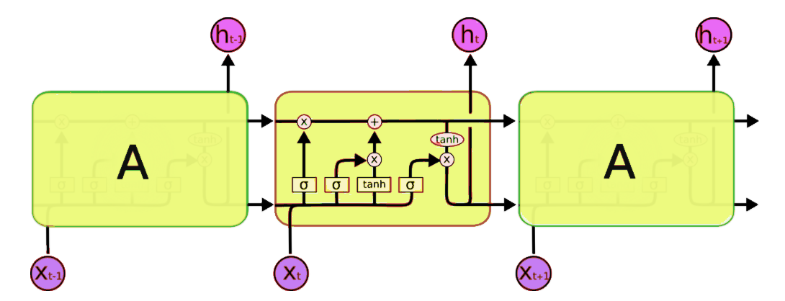
Long Short Term Memory
Traditional NN can’t understand based on previous observations.
These can learn historical trends.

Slide 15
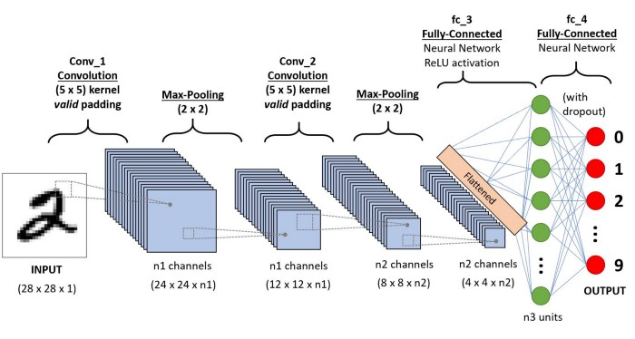
CNN
Inspired By Visual Cortex, Breaks down data.
Recognises Local Trend

